Slide 1
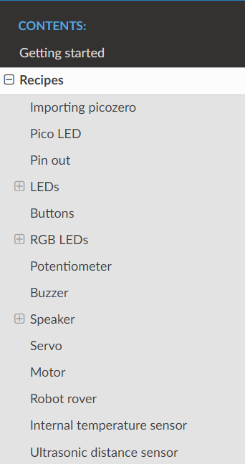
The picozero library documentation is found in this link. Use the wiring diagrams
In the following pages to test our the suggested programmes (Recipes)
https://picozero.readthedocs.io/en/latest/recipes.html#importing-picozero
Click Recipes and follow the exercises for
You can use one of your buzzers as speaker

Slide 2
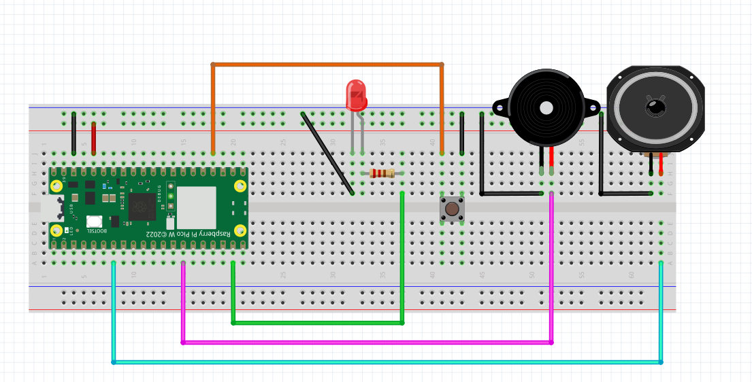
Testing the picozero Library
LED Button Buzzer Speaker

Slide 3
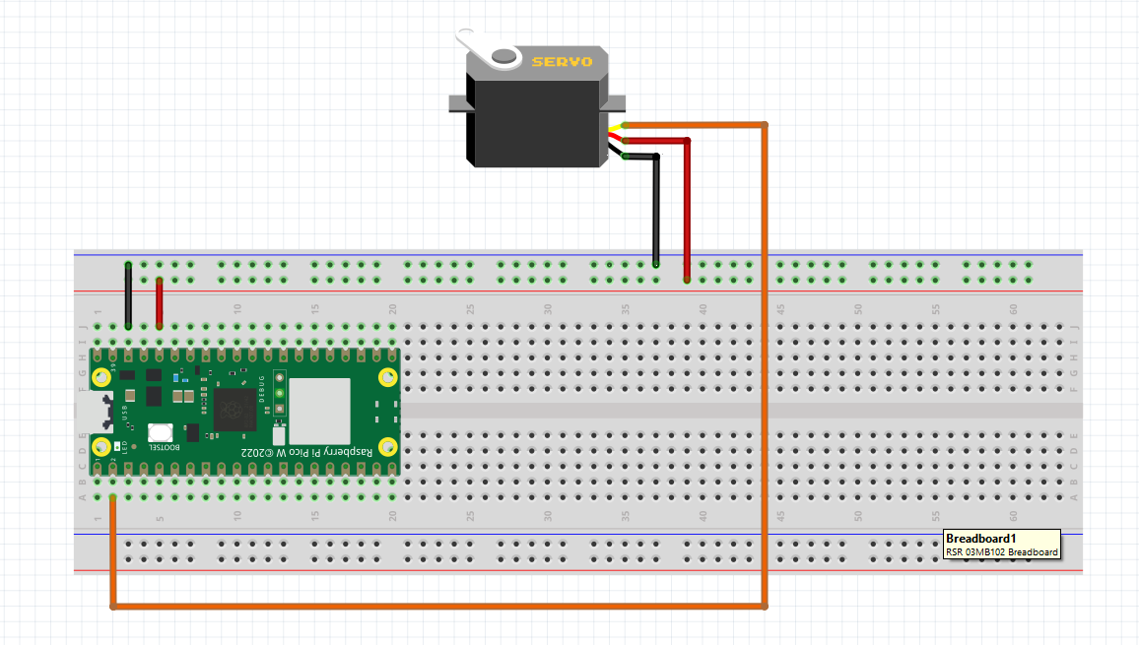
Testing the picozero Library
Servo

Slide 4
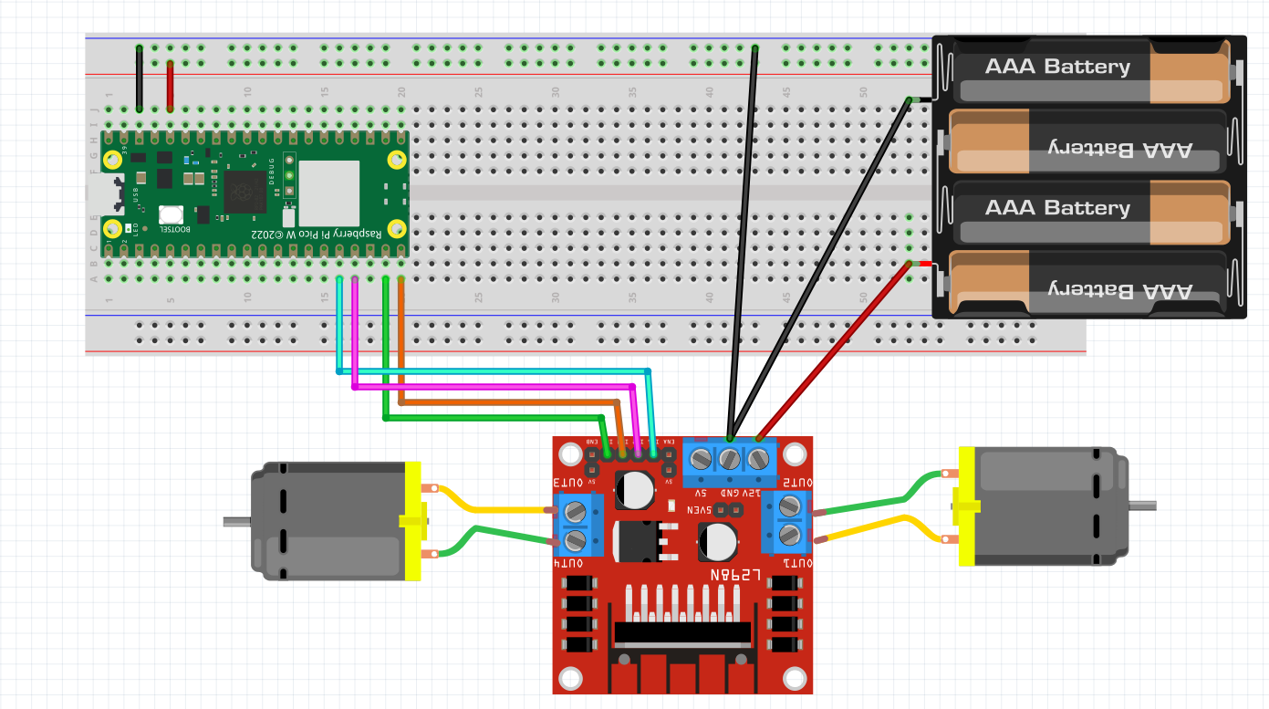
Testing the picozero Library
Motor / Robot

Slide 5
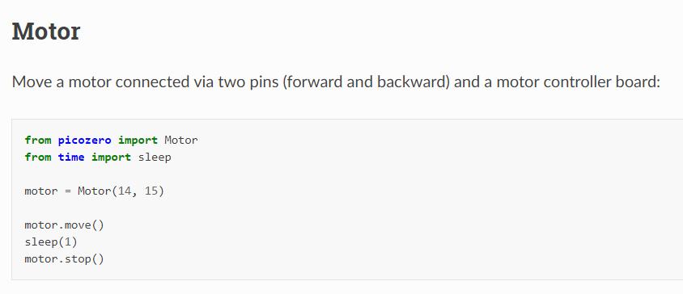
motor.forward()
There’s some error in the documentation

Slide 6
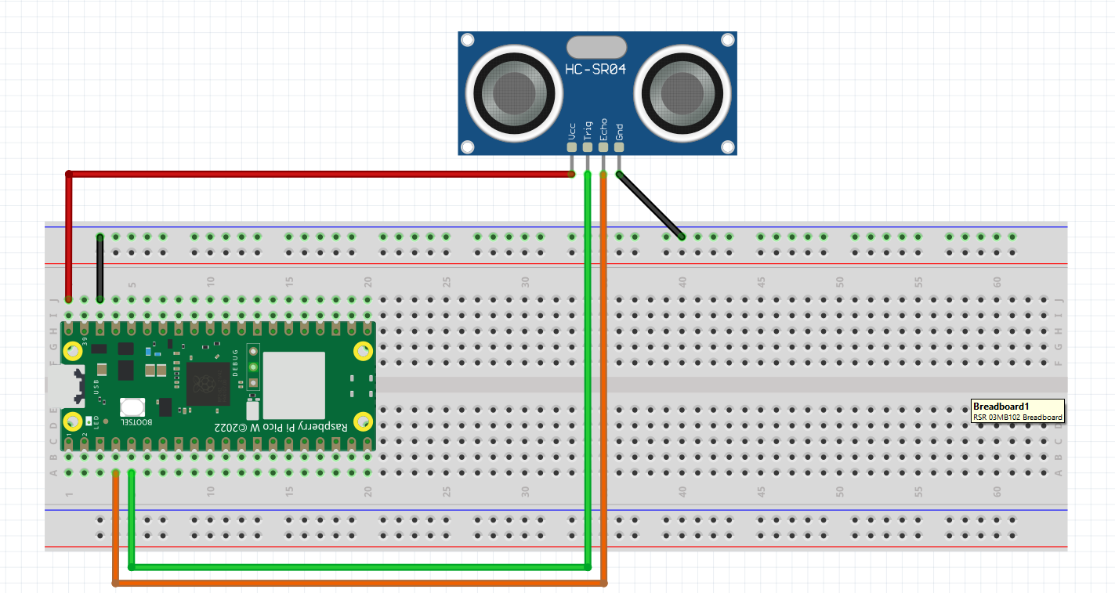
Testing the picozero Library
DistanceSensor
VBUS

Slide 7
RUNNING PICO UNTETHERED TO LAPTOP
Save program as main.py
Use power bank to power Pico

